Slide 1
Operating Systems
Process
FBA

Slide 2
Process Concept
What to call the activities of CPU ?
User Programs
or
Tasks
Jobs
Batch System
Time Sharing System
These activities are called “Processes”
The terms “job” and “process” are used almost interchangeably.
Notes:
A question that arises in discussing operating systems involves what to call all the CPU activities.
A batch system executes jobs, whereas a time-shared system has user programs, or tasks.
A single-user system, a user may be able to run several programs at one time: a word processor, aWeb browser, and an e-mail package.
Even if a device or system does not support multitasking, the operating system may need to support its own internal programmed activities.
In many respects, all these activities are similar, so we call all of them processes.
Although we personally prefer the term process, much of operating-system theory and terminology was developed during a time when the major activity
of operating systems was job processing.

Slide 3
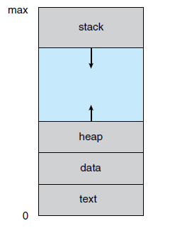
Process
A process is a program that is in execution.
But, it is more than the program codes. Program code is known as “text section” of a process.
Besides code of the program, it contains -
Program Counter and Registers: stores current activity of the process
Stack: Temporary data (function parameter, local variables, return addresses etc.)
Data Section: Global Variables
Heap: dynamically allocated memory during runtime

Slide 4
Program Vs Process
Program is a collection of instructions that can be executed
A program is a passive entity.
A process is an active entity.
A program becomes a process when it is loaded into memory for execution.
next address to execute
Program counter
Program
Loaded into
memory
a=10
b=5
print(a+b)
…
...
Value of a is 10
Data section
program1.exe
print(a+b)
b=5
Text section
a=10
Corresponding process in memory

Slide 5
Same program, Different Process
Process 1
Browser ( first window)
Code 1
Program code is same
Data, Heap, Stacks contains different information
Process 2
Browser ( second window)
Browser program
Process 3
Browser ( third window)

Slide 6
States of a Process
A process state defines the current activity of that process.
The states a process can be:
New: Process is being created
Running: Instructions are being executed
Waiting: Process is waiting for some event to occur
Ready: Waiting to be assigned to a processor
Terminated: Process has finished execution

Slide 7
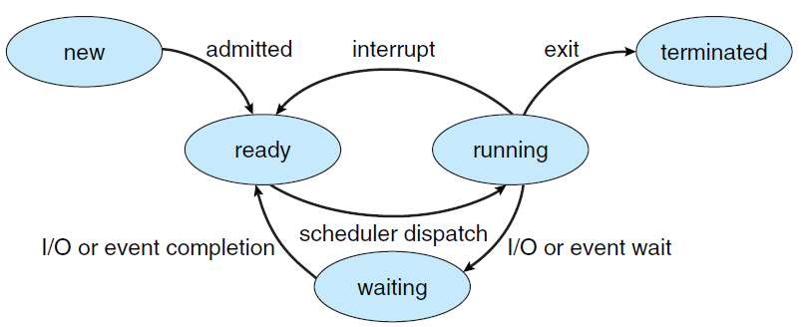
Process State Diagram

Slide 8
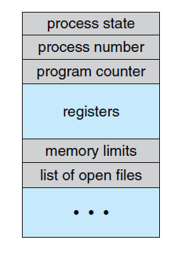
Representation of Processes in OS
Each process is represented in the operating system by a Process Control Block (PCB)
PCB is a data structure to store information of Processes such as -
Process state
Program counter
CPU registers
CPU scheduling information
Memory-management information
Accounting information
I/O status information

Slide 9
Operating Systems
Process Scheduling
FBA

Slide 10
Process Scheduling
Multiple process is ready to execute.
But, which Process should be executed first?
P1
P4
P1 -> P3 -> P2 -> P4 -> P5 ?
CPU
P2
P1 -> P2 -> P3 -> P5 -> P4 ?
P3
P5
CPU expecting processes to execute
Processes needs to be executed

Slide 11
Scheduling Queue
Stores the processes in different steps of OS.
Different queues are maintained in different steps.
Device 1
CPU
Device Queue
Job Queue
Ready Queue
Device Queue
Reside in Secondary Memory
Keeps all the processes of the system
Reside in Main Memory
Keeps all the processes that are waiting to be executed.
Processes wait here for the device to be free
Device 2

Slide 12
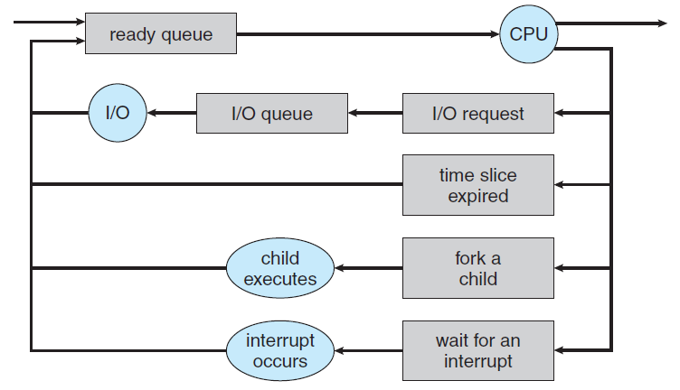
Queueing Diagram
Fig: Representation of Process Scheduling using Queueing-Diagram

Slide 13
Schedulers
Schedulers select processes from different queues to be passed to the next phase.
CPU
Long Term Scheduler
Short Term Scheduler
Job Queue
Ready Queue
Less frequently executed.
Controls degree of multiprogramming.
More frequently executed.

Slide 14
CPU Bound Vs I/O Bound Process
CPU bound processes spend more time doing computation using processors than I/O.
I/O bound processes spend more time in I/O than CPU.
Long Term Scheduler must select wisely !
What will happen if all processes are I/O bound ?
=> Empty ready queue
What will happen if all processes are CPU bound ?
=> Empty waiting queue
CPU
Ready Queue
End
I/O
I/O Queue

Slide 15
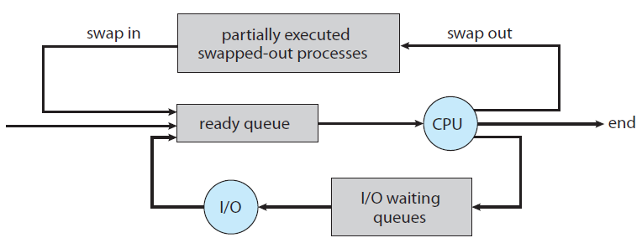
Medium Term Scheduler
Time-sharing system may use this scheduler.
Swapping reduce the degree of multiprogramming.
Fig: Addition of swapping in Queueing-Diagram

Slide 16
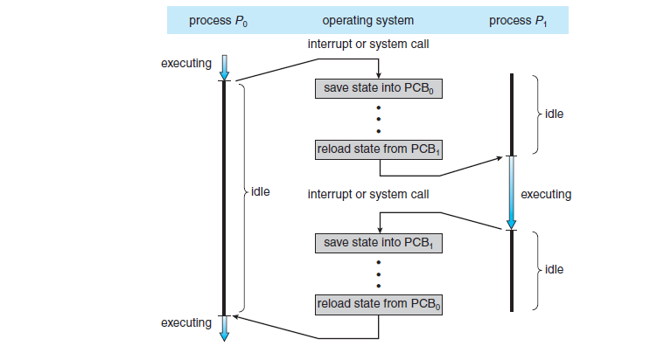
Context Switch
When an interrupt occurs, the system needs to save the current context (state) of the process running on the CPU.
Context Switch: 1. Storing currently executed process context
2. Restoring the next process context to execute
Overhead for context switch from P0 to P1
Overhead for context switch from P1 to P0

Slide 17
Operating Systems
Operations on Process
FBA

Slide 18
Process Creation
A process is identified by a unique PID (Process Identifier) in the OS.
A process may create new processes.
P1
pid = 1
Parent process
P2
pid = 8
P3
pid = 58
P4
pid = 63
Child process
P5
pid = 51
P6
pid = 38
P3
pid = 55
Child process obtain resources from OS or are restricted to Parent’s resources
Parent process may pass initializing data to child process

Slide 19
Process Creation
When a process creates new process -
The parent continues to execute concurrently with its children
Or,
The parent waits until some or all of its children have terminated
Two address-space possibilities for the new process -
The child process is a duplicate of the parent process
Or
The child process has a new program loaded into it.

Slide 20
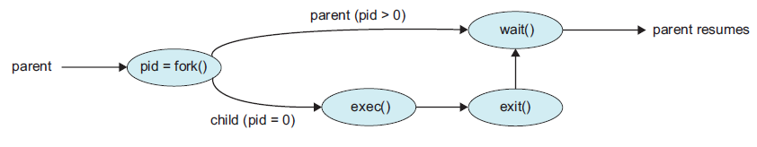
Process creation in UNIX
System Call: offers the services of the operating system to the user programs.
fork(): create a new process, which becomes the child process of the caller
exec(): runs an executable file , replacing the previous executable
wait(): suspends execution of the current process until one of its children terminates.
Fig: Process creation using fork() system call

Slide 21
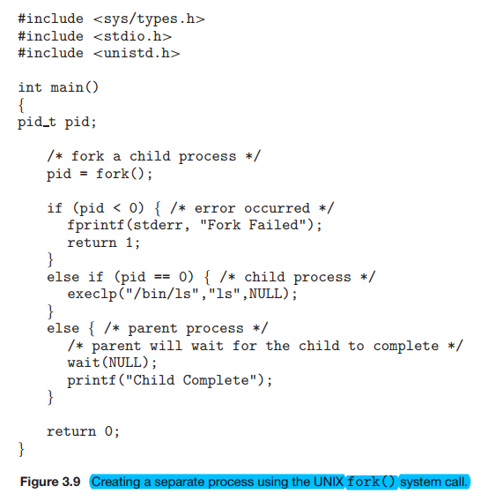

Slide 22
int main(){
fork();
fork();
printf(“A”);
}
int main(){
fork();
fork();
fork();
printf(“A”);
}

Slide 23
int main(){
a = fork();
if(a==0) fork();
fork();
printf(“A”);
}
int main(){
fork();
a = fork();
if(a==0) fork();
printf(“A”);
}

Slide 24
int main(){
int x = 1;
a = fork();
if(a==0){
x = x -1;
printf(“value of x is: %d”, x);
}
else if (a>0){
wait(NULL);
x = x +1;
printf(“value of x is: %d”, x);
}
}

Slide 25
Process Termination
A process is terminated when -
It executes its last statement
Or
Termination cause by another process
When a process is terminated, the resources are deallocated.
A parent may terminate its child if -
Child has exceeded the usage of resources
Task assigned to child is no longer needed
Parent is exiting ( cascading termination)

Slide 26
Zombie Process in UNIX
Parent Process
wait()
Parent Process
fork()
Child Process
Child Process
Zombie Process
exec()
exit()

Slide 27
Operating Systems
Interprocess Communication
FBA

Slide 28
Processes in the system
Processes running concurrently may be -
Independent (cannot affect or be affected by other process)
Or
Cooperating (can affect or be affected by other process)
Process cooperation is needed for -
Information sharing
Computational speedup
Modularity
Convenience

Slide 29
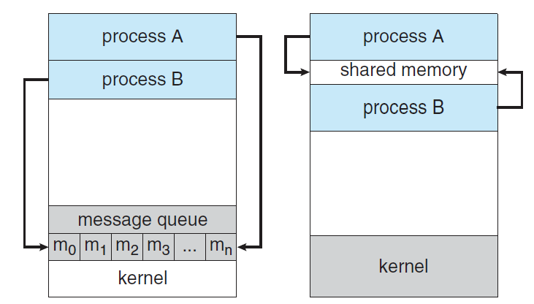
Inter Process Communication
IPC is a mechanism to exchange data and information among processes.
Two fundamental model of IPC -
Shared Memory
Message Passing

Slide 30
Shared Memory System
(Producer-Consumer Problem)
Producer: produces products for consumer
Consumer: consumes products provided by producer
Produce
Share Space /
Buffer
Consume
Producer
Consumer

Slide 31
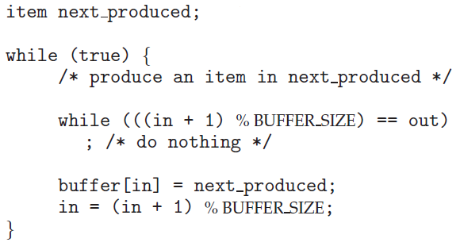
Producer-Consumer Problem (Producer)
in: next free position in buffer
out: first full position in buffer
Both initialized with 0.
in = 0
out = 0
Here, BUFFER_SIZE = 7
When buffer is full,
in = 6 , out = 0
When buffer is not full,
In = 4, out = 0
[0] [1] [2] [3] [4] [5] [6]
[0] [1] [2] [3] [4] [5] [6]

Slide 32
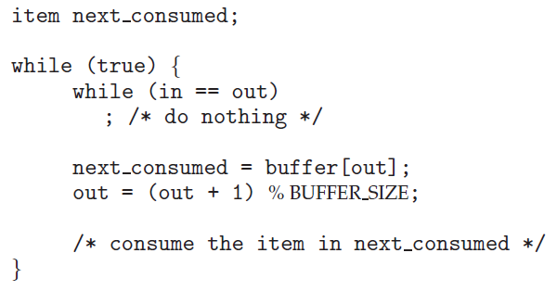
Producer-Consumer Problem (Consumer)
in: next free position in buffer
out: first full position in buffer
Both initialized with 0.
in = 0
out = 0
Here, BUFFER_SIZE = 7
When buffer is empty,
in = 0 , out = 0
When buffer is not empty,
In = 5, out = 0
[0] [1] [2] [3] [4] [5] [6]
[0] [1] [2] [3] [4] [5] [6]

Slide 33
Message Passing System
If processes P and Q want to communicate, they must send messages to and receive messages from each other.
A communication link must exist between P and Q.
send(message)
P
Q
M1
M2
M3
M4
receive(message)
Useful for exchanging small amount of data
More suited for distributed systems than shared memory

